Slide 1

Add Team Members Names here

Slide 2
UN SDG Goal
Good Health
Team member names: Pratiksha Shreya Baxla,Praisy Petra
Registration number:URK21CS3014,URK21CO3006
K-Mail : pratikshashreya@karunya.edu.in
praisypetra@karunya.edu.in
GitHub Repository Link:URK21CS3014
https://github.com/URK21CS3014/temp3
GitHub Repository Link:URK21CO3006
https://github.com/URK21CO3006/temp3

Slide 3
TABLE OF CONTENTS
Problem Statement And Mapping With UN SDG
Solution Found And Dataset Used
Data Analysis And Model Building
Insights Gained And References Used

Slide 4
PROBLEM STATEMENT
Given the health data of various countries with different years ,as we know health varies from person to person , taking it as a big population it might vary in a large scale when it is compared to different countries and years, It also gives us a brief idea about the country's overall development and contribution in the field of health. Thus, this model is made to focus upon the country's health status in the upcoming years by making a brief comparison among other countries and changes that occurred throughout the years

Slide 5
SOLUTION
Dataset that we used in this project is that WHO regional life expectancy,
The solution that is produced through this model is that life expectancy would drastically increase in the upcoming years, most importantly in the western-pacific whereas significant changes can be observed in Africa.
Thus from the model we built, we can infer that population can affect the country’s overall development resulting in various advantages and disadvantages to the country

Slide 6
DATASET USED
The Dataset that we used during this session is that WHO Regional Life Expectancy dataset
Link: https://drive.google.com/drive/folders/1Ciaj0v9iS8qCS7aTcrJRzSnMX0kN4nb\

Slide 7
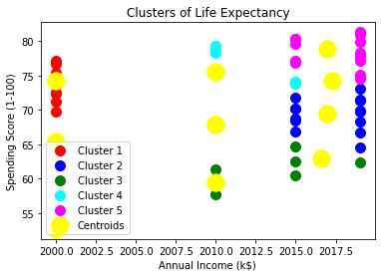
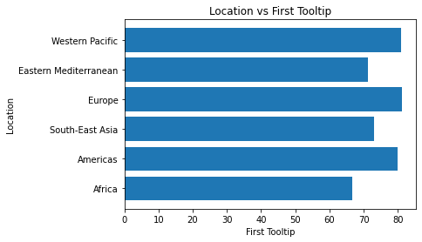
DATA VISUALIZATION
As we can see from the data that depending on the years the life expectancy of a particular country may vary
As we can see from the data that depending upon the location the first tooltip varies from places to places

Slide 8
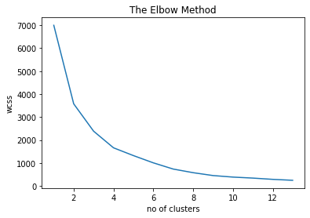
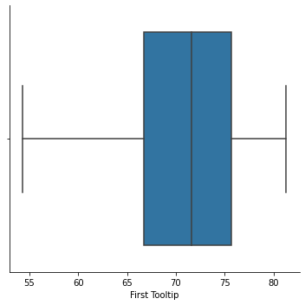
DATA VISUALIZATION
As we can see from the data The elbow method runs k-means clustering on the dataset for a range of values given for the k
As we can see from the data that we calculated Z-Score and formed a Box plot out of the given data

Slide 9
MODEL BUILDING
Train the dataset: Our dataset has been trained using Data science particularly using K-Mean model
The tools which we used for this program is Google Colab and the algorithm which is used for this model is Python
About the model: Initially the dataset is cleaned after collecting the data,the duplicates and unncessary informations are droped and cleaned in the first process.Secondly,precisions are made over the data to get an accurate value over the model,thirdly data visualizations are made from the accurate values to get a clear picture of the model.
Thus we have concluded that population might affect the country’s overall development. This might be both an advantage and disadvantage depending upon the country’s wealth and resources
Overall idea of the model gives us a suggestion that upcoming population must be reduced thus leading to a healthy environment and good health.

Slide 10
PERFORMANCE METRICS
The performance metrics of the model which we made has a precision of 0.5 and with an accuracy of 1.0 which is overfitting due to small amount of data however the model can be a bit accurate about the population in the upcoming years

Slide 11
INSIGHTS GAINED AND REFERENCES USED
Through this project we have gained a vast insights from the model that as years pass by the population might vary from country to country depending upon the resources the health might vary in various countries
References that we used in the project are:
https://scikit-learn.org/stable/modules/generated/sklearn.metrics.mean_absolute_error.html#sklearn.metrics.mean_absolute_error
https://www.geeksforgeeks.org/python-pandas-get_dummies-method/
https://stackoverflow.com/questions/34007308/linear-regression-analysis-with-string-categorical-features-variables

